Slide 1
FILE and folder EXPLORER
ANUPAM MISHRA(16BCS2421)

Slide 2
INTRODUCTION
File and Folder Explorer is an application to view/add/delete Files and Folder in Memory or System Storage.
This also helps in navigating to a particular file location nad to show/hide hidden Files and Folder. This document [provides details about the entire File and Folder Explorer.

Slide 3
Functional specification
Module of the system:
Root Directory Panel
Open Folder Panel without Hidden Files and Folders
Open Folder Panel with showing all Files and Folders
Adding or Creating new Folder or File
Deleting existing File or Folder
Navigating Back to Parent Directory

Slide 4
Hardware and Software Requirement
Hardware Requirement :-
Software Requirement :-
OPERATING SYSTEM :-
Window XP or Any Equivalent Operating System
NETBEANS 8.2 64 BIT
ECLIPSE NEON 3
JDK 8 or 10
PROCESSOR :-
Processor 1.6 GHZ
RAM :- 1 GB
Hard Disk :- Minimum 20 GB

Slide 5
FEATURES
Easy Environment to access and Explore any Directory
Show/ Hide Hidden Files and Folder
Add new Files and Folder
Delete existing File or Folder
Go To any specific File Location
See Memory space Percentage of Root Directory
Open any File or Folder

Slide 6
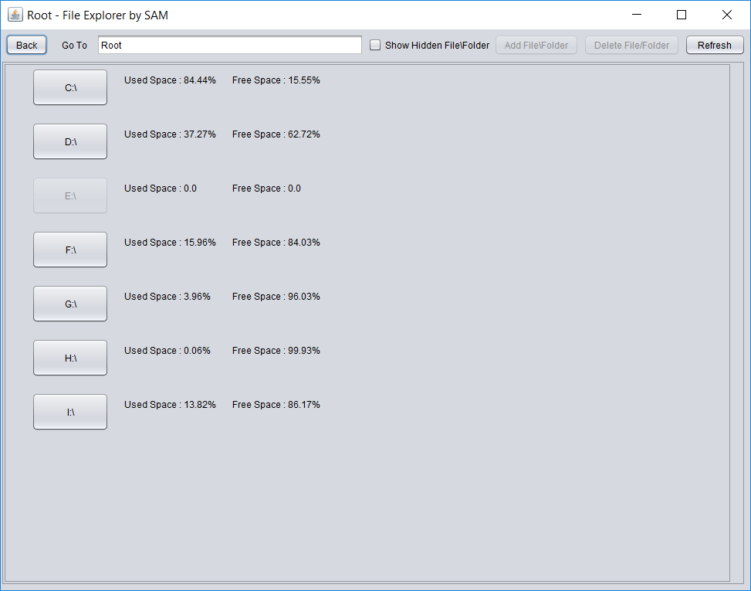
ROOT Directory

Slide 7
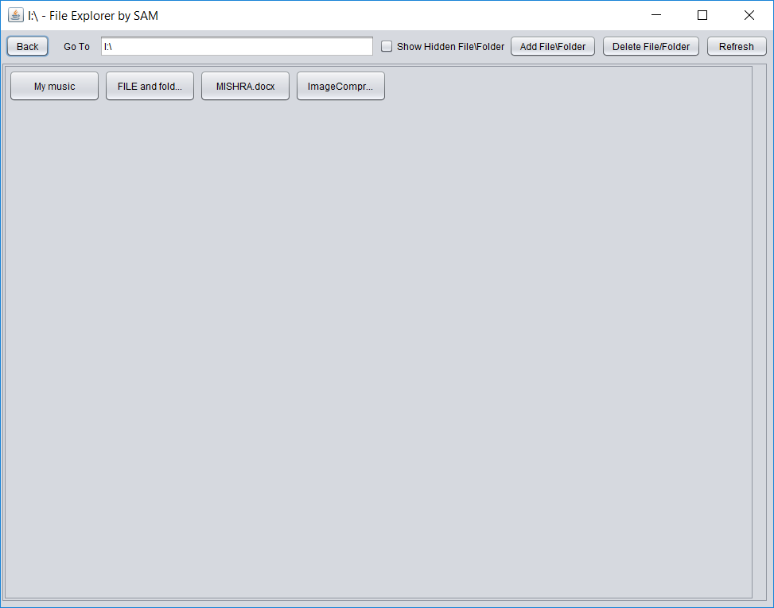
Open any Folder without hidden Files or folder

Slide 8
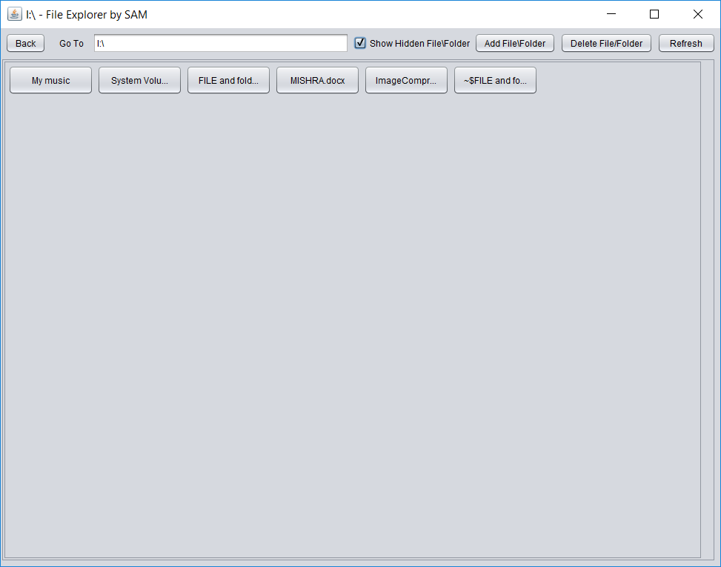
Open any Folder with hidden Files or folder

Slide 9
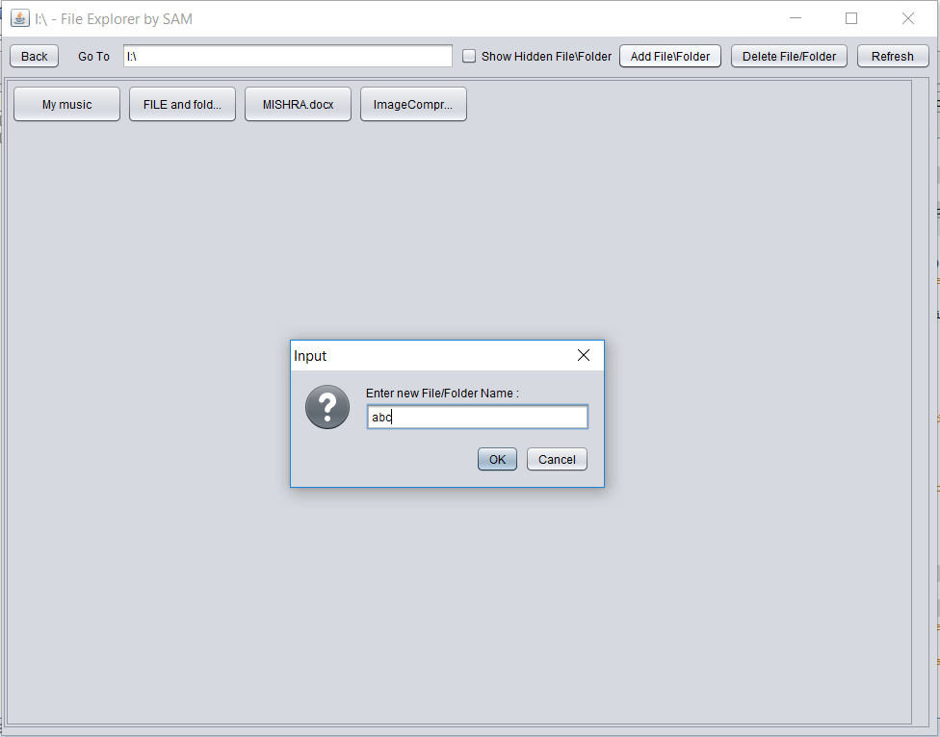
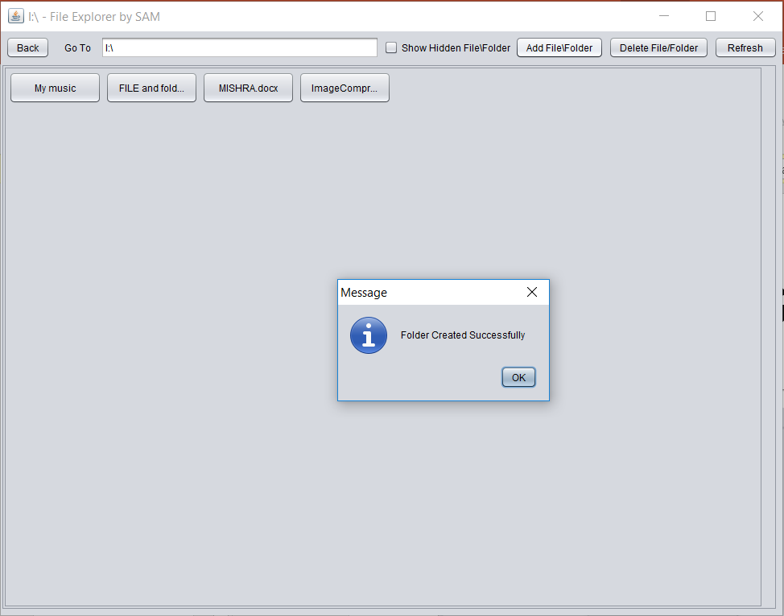
Adding File or Folder

Slide 10
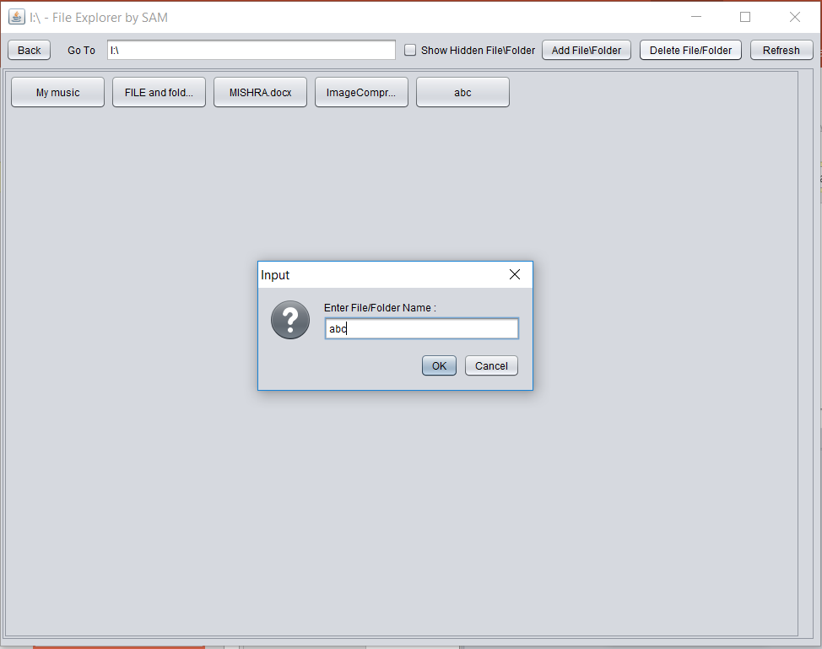
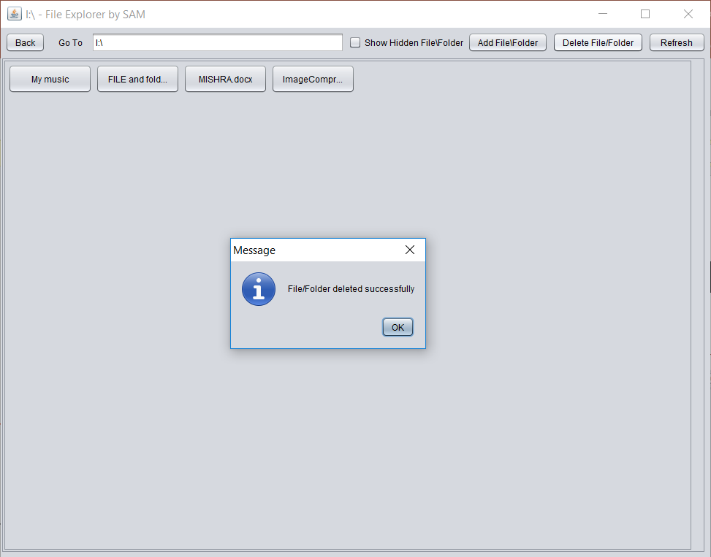
Deleting File/folder

Slide 11
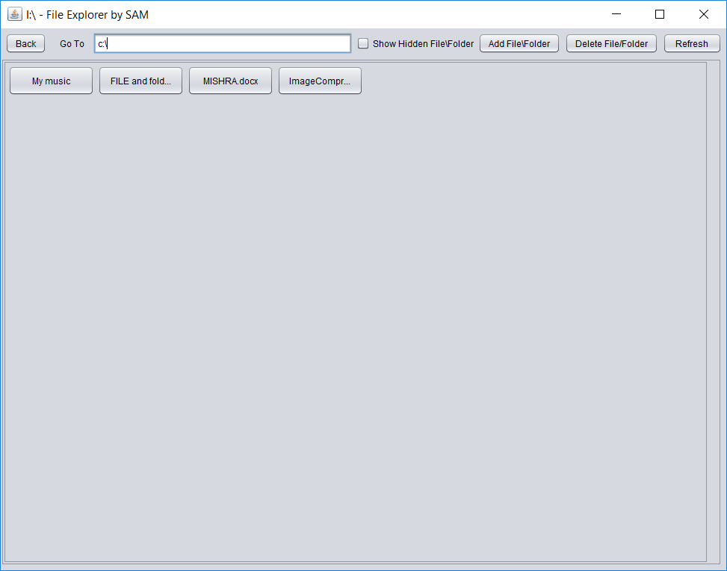
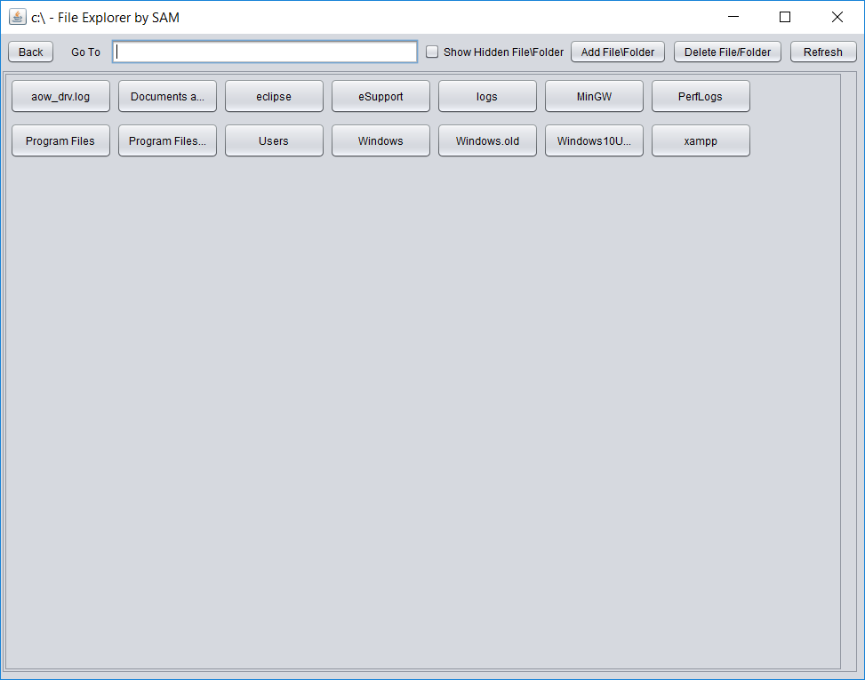
Directly Go to File/folder

Slide 12
Bibliography / References
During the development of our system, we have taken the reference from various books and journals, which we would like to mention in this section.
Book Referred:- How to Java
Javatm2(Patrick Naughton)
Referring Online manual from website:-
https://stackoverflow.com/java/
https://www.tutorialspoint.com/java/index.htm
https://www.geeksforgeeks.org/java/
https://www.tutorialspoint.com/java/index.htm

Slide 13
THANK YOU

